Slide 1

Capstone Project
Cross-selling
Medical products
Notes:
Good morning everyone, i will be presenting u, my capstone project on cross selling medical products.

Slide 2

Problem statement
A Medical Multi-National Company based in Singapore is seeking opportunities to increase the market share across South-east Asia.
However, due to commercial confidentiality, we are unable to disclose further information.
We are able to obtain Customer Id, Country - AU & NZ, Region, Division, Product information, Date of transactions, Invoiced Value. With that, recommendation and illustration on what/how to increase the market shares based on the analysis from the data given.
Note: Monetary analysis is out of scope
Notes:
I was approach by a MNC based in singapore, they would like to explore opportunities to expand their business in South-east asia, but for this project, our focus will be on Australia and new zealand. However, because of commercial confidentiality, we are only able to obtain basic information just barely adequate for my analysis. With that, recommendation and illustration will be presented in this project.
On a side note, due to the limited information, monetary analysis will be out of scope, we will focus more on quantitative analysis.

Slide 3
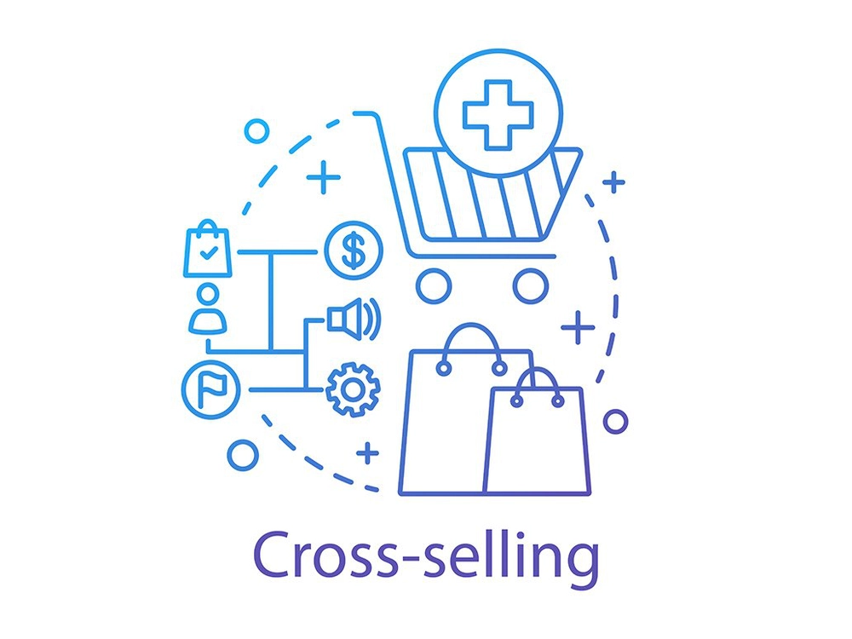



Objectives
Quantify recommended products
Cross-selling products
Sales
forecast
What can we cross-sell to existing customers?
How many can we recommend to individual customers?
What/Where should we focus resources on?
Notes:
For this project, i have splitted the objective into 3, first will be to identify what products can we cross sell to existing customers, for example, what other similar product to recommend to those that customers that have not purchase before.
Second, to quantify the recommending products to the potential customers.
Lastly, what or where should we focus resources on? For example, which division or material should we pay more attention to?

Slide 4

01
Cross-Selling Product
Mixed Basket Analysis (MBA) / Collaborative Filtering (CF)
Notes:
Before going to the findings, i would like to briefly explain what and how the package ive used to come out with a list of recommending products.
So basically, I have used mixed basket analysis in short MBA, and collaborative filtering in short CF.

Slide 5
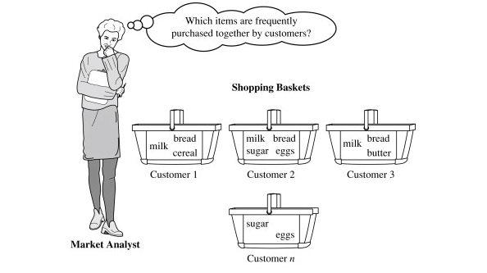
Mixed Basket Analysis (MBA)
What is Mixed Basket Analysis?
Mines frequent itemset purchased and discover associations and correlations between itemset
It identifies customer buying habits between the different items purchased in their “shopping baskets”
The discovery of this kind of association helps to gain insights in which items are frequently bought together by customers.
It can apply discovered association to existing customer who has not purchased the itemset combinations.
Notes:
So what is MBA?
MBA is an algorithm to calculate association and correlation from past purchase transactions to find out what combination of products can be purchased together.
With that, if the customer only purchased one of the item in that combination, we can recommend the other item within that combination.
In simpler term, we are encouraging customers to purchase bundle package.

Slide 6
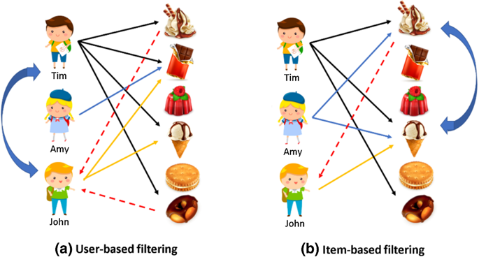
Collaborative Filtering (CF)
What is Collaborative Filtering?
Two types of algorithms, User-based filtering and Item-based filtering .
User-based collaborative filtering algorithm recommends based on similarities among customers
Item-based collaborative filtering algorithm recommendations are created not just based on similarities between customers but also on correlations between products/items.
Notes:
So what is CF? CF has two type of sections, namely Item-based and User-based filtering. But for this project, we will be focusing on Item-based filtering.
So For Item-based filtering, it works very similar with MBA, it calculates the similarity and correlations among the items purchased and gives a list of items with similarity rating against enquired item.
In other words, if i enquiry product ABC in CF, i will have a list of similarity rating for every item and i will pick the top 20 of the item list to cross validate with MBA.
I will explain further in next slide on how i finalize my list of recommending product by cross validating between both models.

Slide 7


MBA & CF cross validation
MBA (Combination): -
Product ABC | XYZ
Product BCE | EFG
Product GHI | IJK
CF (Similarity rating): -
Product ABC | XYZ | 4.5
| BCE | 3.5
| EFG | 2
| GHI | 1
| IJK | 0.5
Product BCE | IJK | 4.5
| XYZ | 3.5
| ABC | 2
| GHI | 1
| EFG | -0.5
Product GHI | XYZ | 4.5
| IJK | 3.5
| ABC | 2
| BCE | 1
| EFG | -0.5
Notes:
For example, on the left hand side, it is the list of item combination from MBA and on the right hand side is the list of similarity rating from CF.
We look at number 1, the combination is product ABC and XYZ, then u refer to the right and u can see that the similarity between ABC and XYZ has a rating of 4.5 which means that MBA is recommending the right product. Thus, we will keep this combination into a list.
Next, look at number 2, Product BCE and EFG have a similarity rating of negative which mean there is no similarity, therefore this combination will be rejected from the list.
Last, look at number 3, Product GHI and IJK have a similarity rating of 3.5. Although it does not have the highest rating, but it has a reasonable similarity thus i will be keeping this combination into the list.

Slide 8


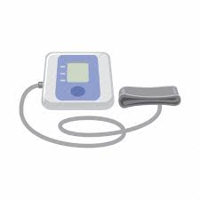
MBA & CF cross validation
Final recommending products:
Product ABC | XYZ
Product GHI | IJK
Notes:
My final recommending list should look like this from previous example.

Slide 9


Before
W/O MBA & CF
After
With MBA & CF
51.8%
52.7%
0.9%
(6,762) customers
bought more than 1
type of Product
(7,743) customers
recommending 1 or
more types of Products
Top 6 Recommending Products (Transactions)
DS100A | MMT-7910W5
MMT-7810W1 | LF1837
186-0106 | LF1937
Recommending
16
Products
Out of 11,101 Products
Involving
2
Business Division
(MITG & Diabetes)
out of 10 Division
Notes:
Now let dive into the findings. Based on past purchase history, there are 52% of the customers bought more than 1 type of product. After implementing both MBA and CF models, it has identified about 1% of potential customers which equivalent to about 1k, to have the opportunity to cross sell the product.
In addition, the models have identified 2 divisions namely MITG and Diabetes to have opportunities on cross selling to existing customers.
And out of 11k of products, 16 products are identified to be able to cross-sell.
On top of that, the table u see here is the top 6 recommending products by transactions.

Slide 10

Quantify
recommended
products
02
Notes:
Next, lets look into how to quantify the 16 recommended products.

Slide 11
Quantify recommended products
Compute existing customer’s buying power against average quantity of the purchased Product.
With the buying power weightage, multiply by average quantity of recommending Product purchased by other existing customers and add back the average quantity of recommending Product
((ŷ - Ŷ) / Ŷ * Ẑ) + Ẑ
((Base_cust average - Base average) / Base average * recommend average) + recommend average
To simulate whether the customer will purchase the recommending product, the final recommended quantity will be multiplied by the probability computed by MBA
Notes:
First, i would need to calculate the buying power of the individual customers. And how do i do that?
Remember the combination that we had in the previous slide?
So the first item we have in the combination we call it the base, its a product that customer A has purchased.
So i get the average quantity of base item purchased by customer A and minus total average quantity of base item purchased then divided by total average quantity purchased.
With that, we have gotten the buying power weightage of customer A, after which multiply by total average quantity of recommending product purchased by all customers and add back the total average quantity of recommending product.
Lastly, ive simulated whether the customer will purchase the recommending quantity by multiplying the probability computed by MBA.

Slide 12
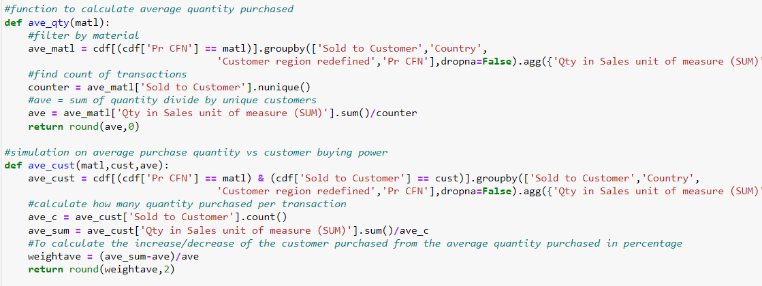
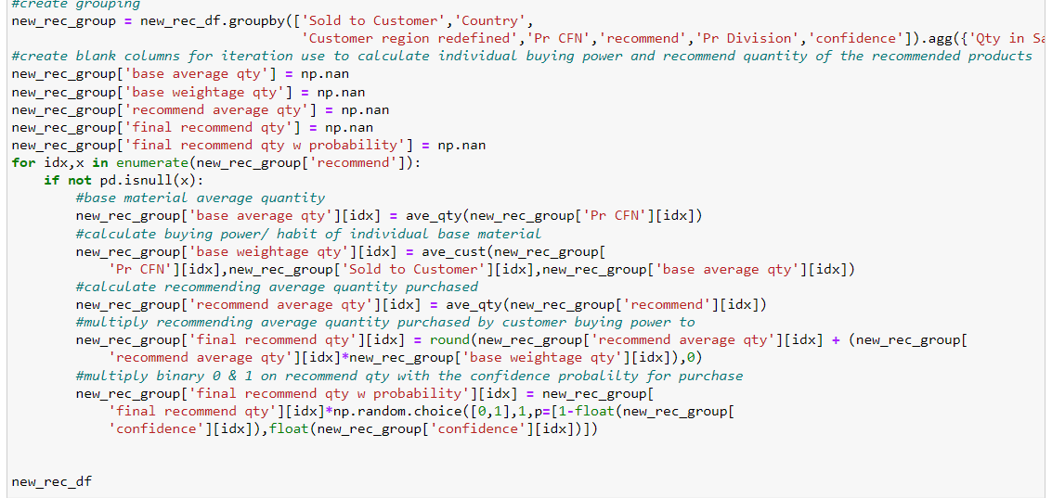

Slide 13
Top 6 recommending Product w quantity
Product | Division | Simulated Qty per Year | Estimated Sales (%) per year
LF1837 | MITG | 65,362 | 22.2%
DS100A | MITG | 45,087 | 16.7%
186-0106 | MITG | 43,695 | 48.7%
LF1937 | MITG | 21,283 | 91.5%
150462 | MITG | 12,083 | 63.7%
MMT-7910W5 | Diabetes | 3,613 | 42.3%
**Assuming simulation happening in coming 1 year
“Company should pay more attention to MITG division on why such a gap between theoretical analysis and practical business function to miss out a huge potential sales opportunity”
Notes:
After applying the formula we had in previous slide, i have identified top 6 recommending product with recommending quantity.
And u can see here the outlook of the simulated quantity and the potential increase of sales per year in percentage.
With that, it is very obvious that the company should pay more attention to MITG division on what is the gap between theoretical analysis and practical business function to miss out such a huge potential sales opportunity available in the market.

Slide 14

Sales Forecast
03
ARIMA & FBprophet
Notes:
Next, we will look into sales forecast’s trend for the next 2 year using ARIMA and facebook prophet on before and after implementing MBA and CF

Slide 15
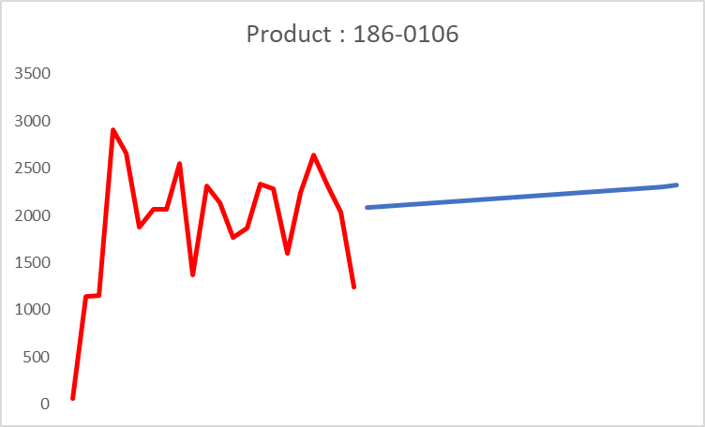
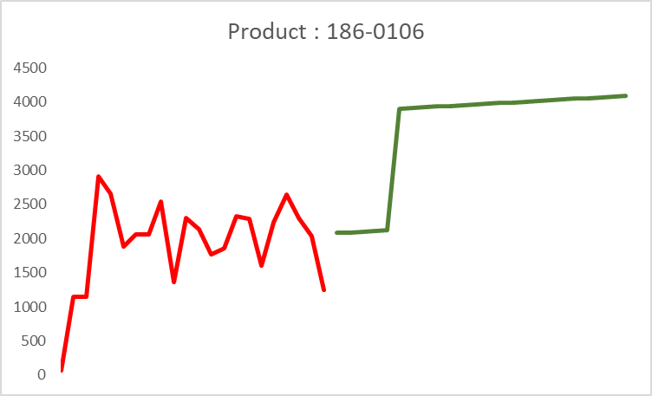
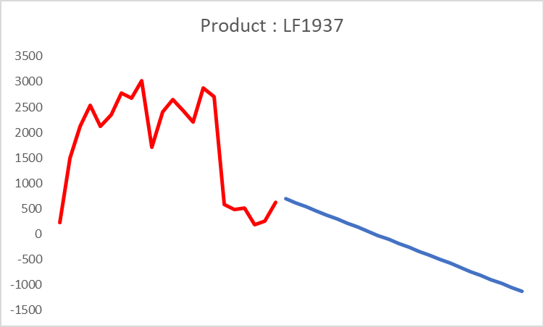
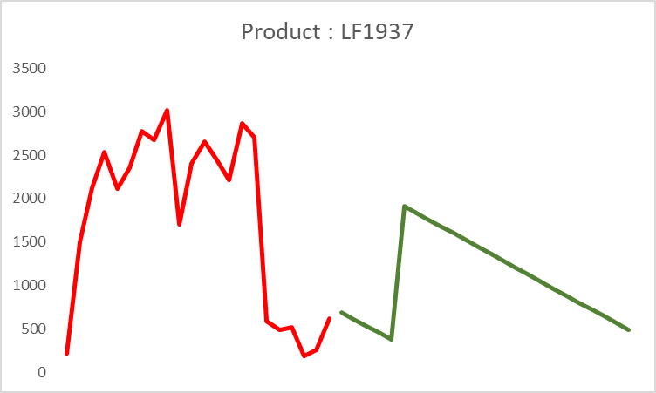
Before
After
Upward trend
Upward trend
Deferring obsoletion?
Possible obsolete product
** Assumption: customers starts to purchase recommending products after Jul’22 and the trend will be consistent until Jan’24
Notes:
Lets look at product 186-0106, it seems normal with an upward trend for before and after implementations.
However, when we look at LF1937, there is a steep decline below zero which can be possible obsoletion happening for this product.
Although after the implementation, there is a spike in july, but it continues with a downward trend.

Slide 16
Before
After
Discontinue or new strategy?
Possible obsolete product
Pending business decision
** Assumption: customers starts to purchase recommending products after Jul’22 and the trend will be consistent until Jan’24
Notes:
Therefore, for the mentioned product, it will be worthy to highlight this abnormality to the management for business decision, whether to discontinue productions or brainstorm a new strategy to bring the sales up again.

Slide 17

Recommendations
We have identified areas such as Product / Division / Region with potential opportunity to promote cross-selling, propose to allocate more resources to identified areas
From sale forecast, we have identified possible obsoleting product which warrant business owner’s attention for decision making
With the computed sales forecast, we can set a reasonable KPI for the business owner to achieve
Notes:
To wrap up the presentation, i would like to recommend that we should allocate and focus on the resources to the right area identified by this project which will eventually lead to expanding market share.
And also to put in the right amount of pressure on sales team with justification of machine learning.

Slide 18
Limitations
Due to limited information given, there is no way to cross validate the relevancy of the combination suggested by the model.
Unable to analyze on user-based to identify customer similarities and the relevancy of the business trade
Has no information on business sales acumen / strategy which may differ from the simulation computed by the models.
Data set has 2 years worth of data point, more data point is necessary to have more accuracy for forecasting.
(ideally 5 years or more)
Notes:
Lastly, i would like to mention the limitation of this project.
Without full access to the information available within the company, the accuracy and reasoning can only base on mathematical theory which can not be entirely practical or logical for real time business.

Slide 19

Thanks
Do you have any questions?
Presented by: Ivan Cho

